Slide 1
Fantastic Iteratively Reweighted Algorithms and Where to Find Them
@ SIAM Conference on Optimization
June 1, 2023
Seattle, WA
Liangzu Peng
Johns Hopkins University → Alibaba Group → University of Pennsylvania

Slide 2
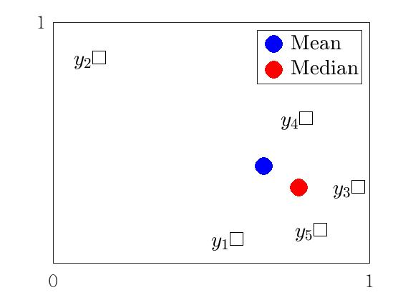
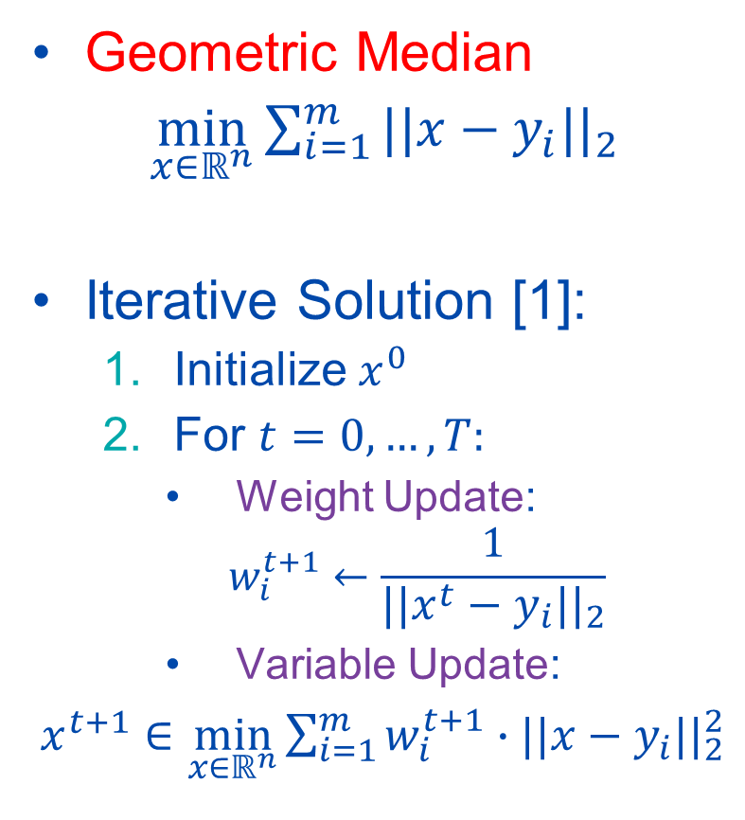

Mean & Geometric Median
Mean
$\min_{x∈ℝ^{n}}{\sum_{i=1}^{m}{{||x−y_{i}||}_{2}^{2}}}$
Closed-Form Solution:
$x=\frac{1}{m}\sum_{i=1}^{m}{y_{i}}$
Geometric Median
$\min_{x∈ℝ^{n}}{\sum_{i=1}^{m}{{||x−y_{i}||}_{2}}}$
Iterative Solution [1]:
Initialize $x^{0}$
For $t=0,…,T:$
Weight Update:
$$w_{i}^{t+1}←\frac{1}{{||x^{t}−y_{i}||}_{2}}$$
Variable Update:
$x^{t+1}∈\min_{x∈ℝ^{n}}{\sum_{i=1}^{m}{w_{i}^{t+1}∙{||x−y_{i}||}_{2}^{2}}}$
[1] E. Weiszfeld. Sur le point pour lequel la somme des distances de n points donnés est minimum. Tohoku Mathematical Journal, 1937.

Slide 3

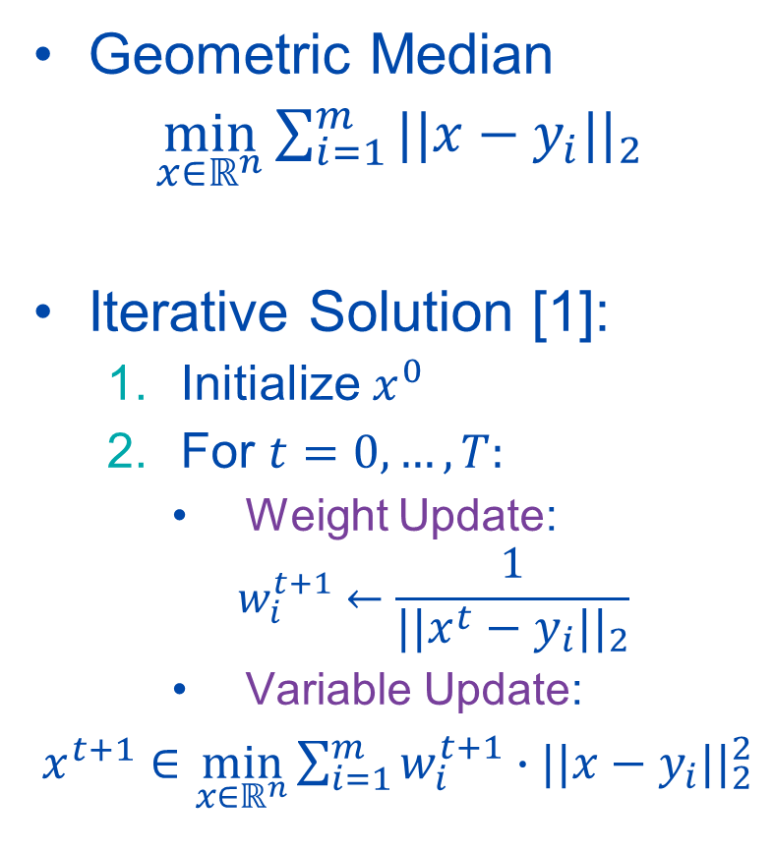
Geometric Median
Geometric Median
$\min_{x∈ℝ^{n}}{\sum_{i=1}^{m}{{||x−y_{i}||}_{2}}}$
Iterative Solution [1]:
Initialize $x^{0}$
For $t=0,…,T:$
Weight Update:
$$w_{i}^{t+1}←\frac{1}{{||x^{t}−y_{i}||}_{2}}$$
Variable Update:
$x^{t+1}∈\min_{x∈ℝ^{n}}{\sum_{i=1}^{m}{w_{i}^{t+1}∙{||x−y_{i}||}_{2}^{2}}}$
Application:
“Median Filter”
[1] E. Weiszfeld. Sur le point pour lequel la somme des distances de n points donnés est minimum. Tohoku Mathematical Journal, 1937.

Slide 4


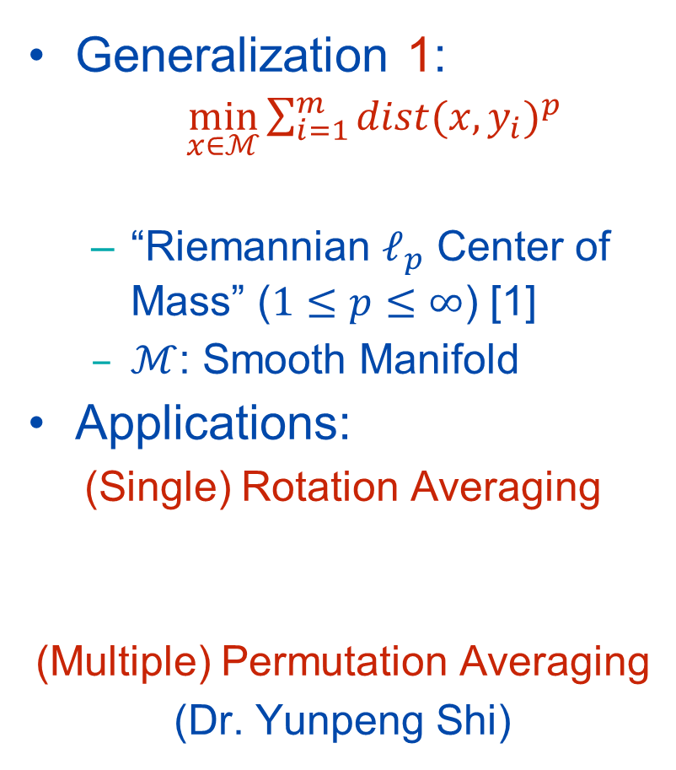

Riemannian $ℓ_{p}$ Center of Mass
Geometric Median
$\min_{x∈ℝ^{n}}{\sum_{i=1}^{m}{{||x−y_{i}||}_{2}}}$
Generalization 1:
$\min_{x∈ℳ}{\sum_{i=1}^{m}{{dist(x,y_{i})}^{p}}}$
“Riemannian $ℓ_{p}$ Center of Mass” ($1≤p≤∞$) [1]
$ℳ$: Smooth Manifold
Applications:
(Single) Rotation Averaging
(Multiple) Permutation Averaging
(Dr. Yunpeng Shi)
[1] B. Afsari. Riemannian $L_{p}$ center of mass: Existence, uniqueness, and convexity. Proceedings of the American Mathematical Society, 2011.

Slide 5
What’s Next?
I will keep talking to you about:
Generalization 2 + Applications (of Iteratively Reweighted Algorithms)
Generalization 3 + Applications
Generalization 4 + Applications
Basic Computational & Theoretical Considerations

Slide 6
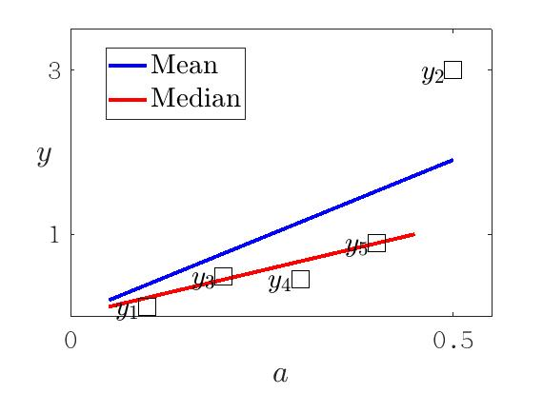

Robust Linear Regression
Geometric Median
$\min_{x∈ℝ^{n}}{\sum_{i=1}^{m}{{||x−y_{i}||}_{2}}}$
“Generalization” 2 $\min_{x∈ℝ^{n}}{\sum_{i=1}^{m}{{|a_{i}^{T}x−y_{i}|}^{p}}}$
“Robust Regression” [1]
($0<p≤1$)
[1] L. Peng, C. Kümmerle, and R. Vidal. Global linear and local superlinear convergence of IRLS for non-smooth robust regression. NeurIPS 2022.

Slide 7

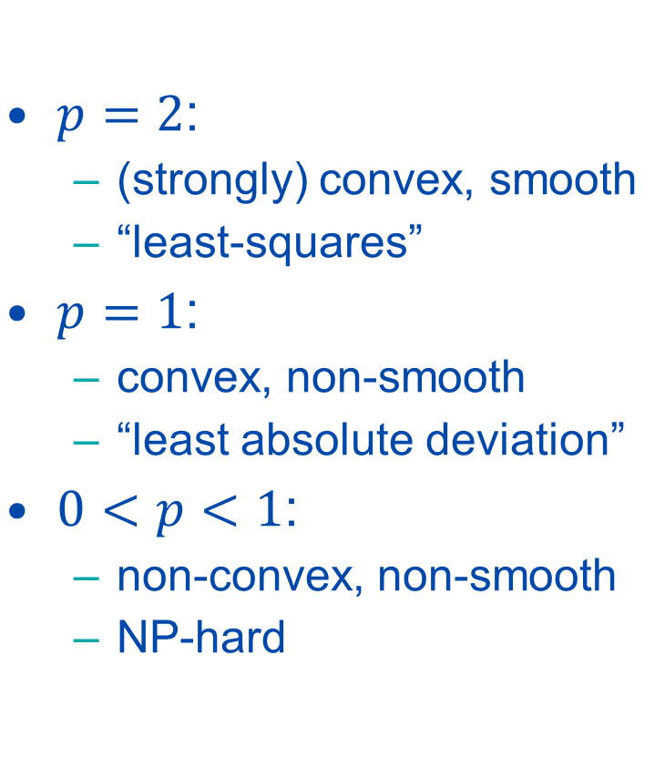
Robust Linear Regression
Robust Regression
($0<p≤1$)
$\min_{x∈ℝ^{n}}{\sum_{i=1}^{m}{{|a_{i}^{T}x−y_{i}|}^{p}}}$
$p=2$:
(strongly) convex, smooth
“least-squares”
$p=1$:
convex, non-smooth
“least absolute deviation”
$0<p<1$:
non-convex, non-smooth
NP-hard

Slide 8
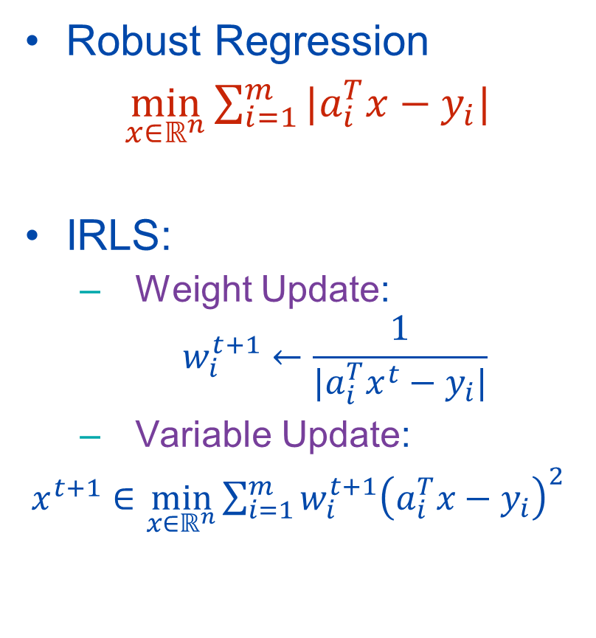

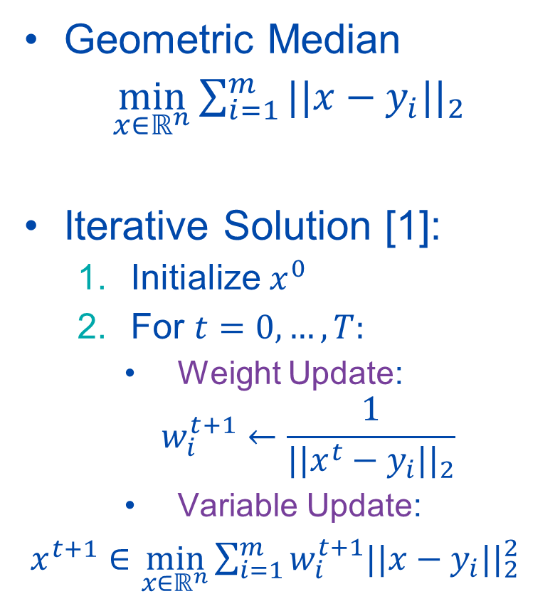
IRLS for Robust Linear Regression ($p=1$)
Geometric Median
$\min_{x∈ℝ^{n}}{\sum_{i=1}^{m}{{||x−y_{i}||}_{2}}}$
Iterative Solution [1]:
Initialize $x^{0}$
For $t=0,…,T:$
Weight Update:
$$w_{i}^{t+1}←\frac{1}{{||x^{t}−y_{i}||}_{2}}$$
Variable Update:
$x^{t+1}∈\min_{x∈ℝ^{n}}{\sum_{i=1}^{m}{w_{i}^{t+1}{||x−y_{i}||}_{2}^{2}}}$
Robust Regression
$\min_{x∈ℝ^{n}}{\sum_{i=1}^{m}{|a_{i}^{T}x−y_{i}|}}$
IRLS:
Weight Update:
$$w_{i}^{t+1}←\frac{1}{|a_{i}^{T}x^{t}−y_{i}|}$$
Variable Update:
$x^{t+1}∈\min_{x∈ℝ^{n}}{\sum_{i=1}^{m}{w_{i}^{t+1}{\left(a_{i}^{T}x−y_{i}\right)}^{2}}}$
Why IRLS works? Or why it doesn’t?
[1] E. Weiszfeld. Sur le point pour lequel la somme des distances de n points donnés est minimum. Tohoku Mathematical Journal, 1937.

Slide 9
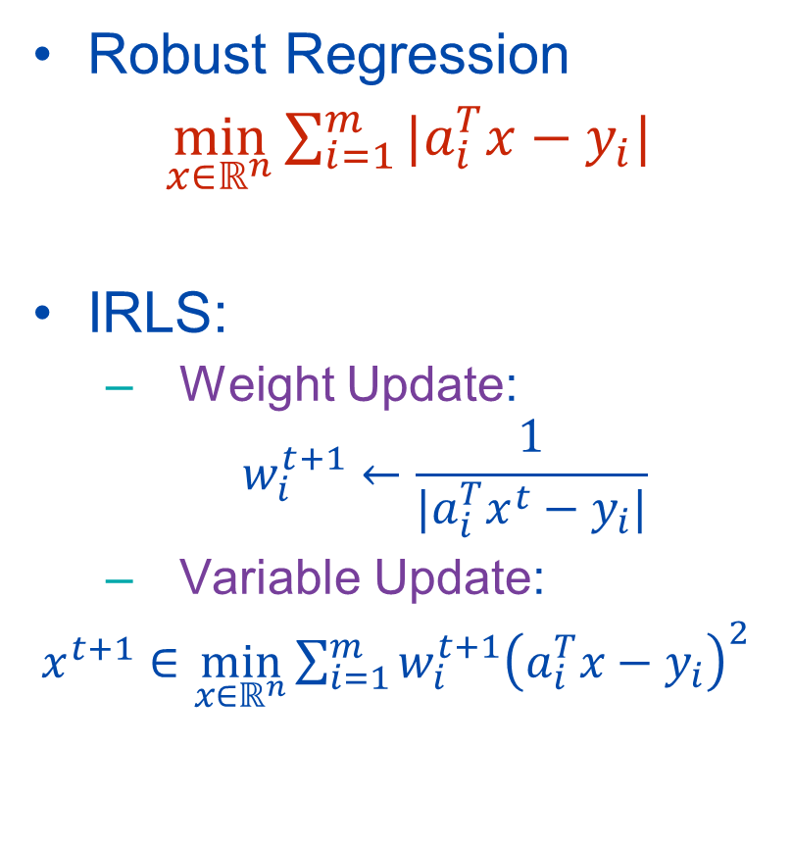
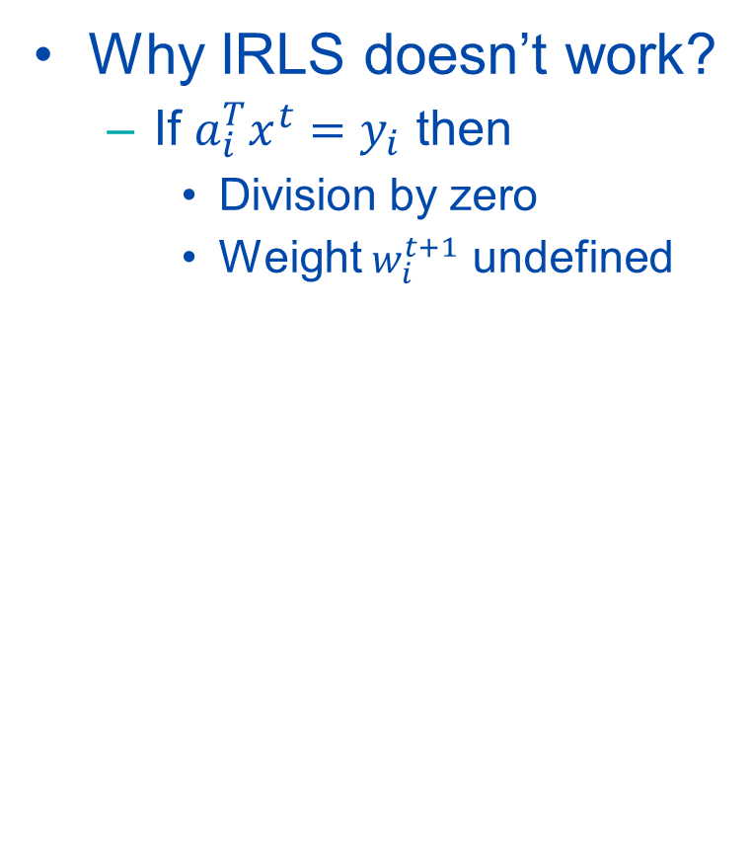
IRLS for Robust Linear Regression ($p=1$)
Robust Regression
$\min_{x∈ℝ^{n}}{\sum_{i=1}^{m}{|a_{i}^{T}x−y_{i}|}}$
IRLS:
Weight Update:
$$w_{i}^{t+1}←\frac{1}{|a_{i}^{T}x^{t}−y_{i}|}$$
Variable Update:
$x^{t+1}∈\min_{x∈ℝ^{n}}{\sum_{i=1}^{m}{w_{i}^{t+1}{\left(a_{i}^{T}x−y_{i}\right)}^{2}}}$
Why IRLS doesn’t work?
If $a_{i}^{T}x^{t}=y_{i}$ then
Division by zero
Weight $w_{i}^{t+1}$ undefined
Why IRLS works? Or why it doesn’t?

Slide 10
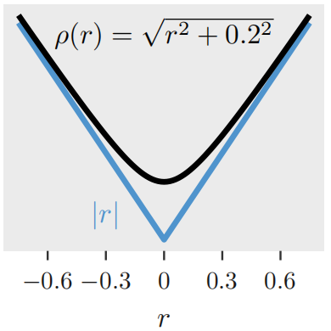

IRLS for Robust Linear Regression ($p=1$)
Robust Regression
$\min_{x∈ℝ^{n}}{\sum_{i=1}^{m}{|a_{i}^{T}x−y_{i}|}}$
IRLS:
Weight Update:
$$w_{i}^{t+1}←\frac{1}{|a_{i}^{T}x^{t}−y_{i}|}$$
Variable Update:
$x^{t+1}∈\min_{x∈ℝ^{n}}{\sum_{i=1}^{m}{w_{i}^{t+1}{\left(a_{i}^{T}x−y_{i}\right)}^{2}}}$
Remedy: Smoothing
$\min_{x∈ℝ^{n}}{\sum_{i=1}^{m}{\sqrt{{ (a_{i}^{T}x−y_{i})}^{2}+ε^{2}}}}$
$ε>0$
Why IRLS works? Or why it doesn’t?

Slide 11
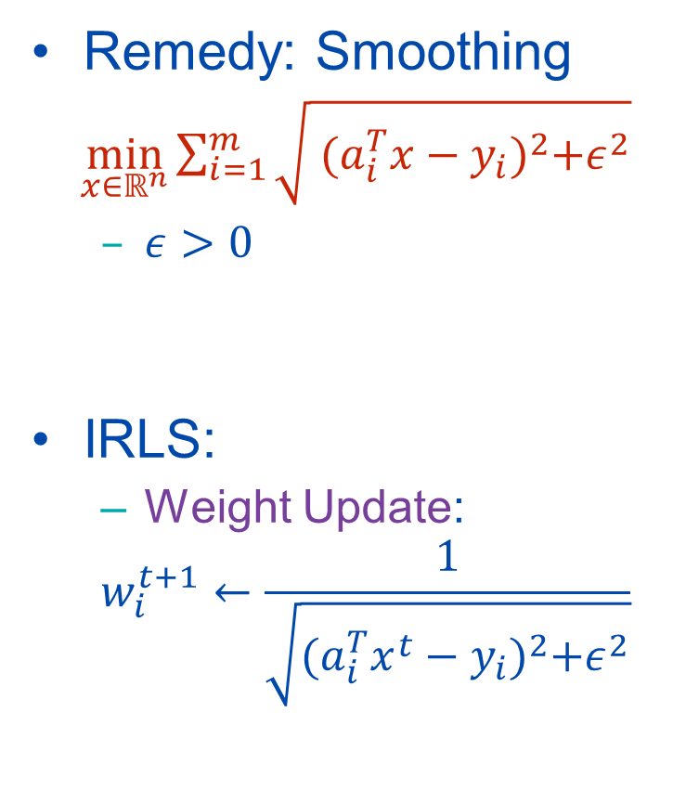
IRLS for Robust Linear Regression ($p=1$)
Robust Regression
$\min_{x∈ℝ^{n}}{\sum_{i=1}^{m}{|a_{i}^{T}x−y_{i}|}}$
IRLS:
Weight Update:
$$w_{i}^{t+1}←\frac{1}{|a_{i}^{T}x^{t}−y_{i}|}$$
Variable Update:
$x^{t+1}∈\min_{x∈ℝ^{n}}{\sum_{i=1}^{m}{w_{i}^{t+1}{\left(a_{i}^{T}x−y_{i}\right)}^{2}}}$
Remedy: Smoothing
$\min_{x∈ℝ^{n}}{\sum_{i=1}^{m}{\sqrt{{ (a_{i}^{T}x−y_{i})}^{2}+ε^{2}}}}$
$ε>0$
IRLS:
Weight Update:
$$w_{i}^{t+1}←\frac{1}{\sqrt{{(a_{i}^{T}x^{t}−y_{i})}^{2}+ε^{2}}}$$
Why IRLS works? Or why it doesn’t?

Slide 12
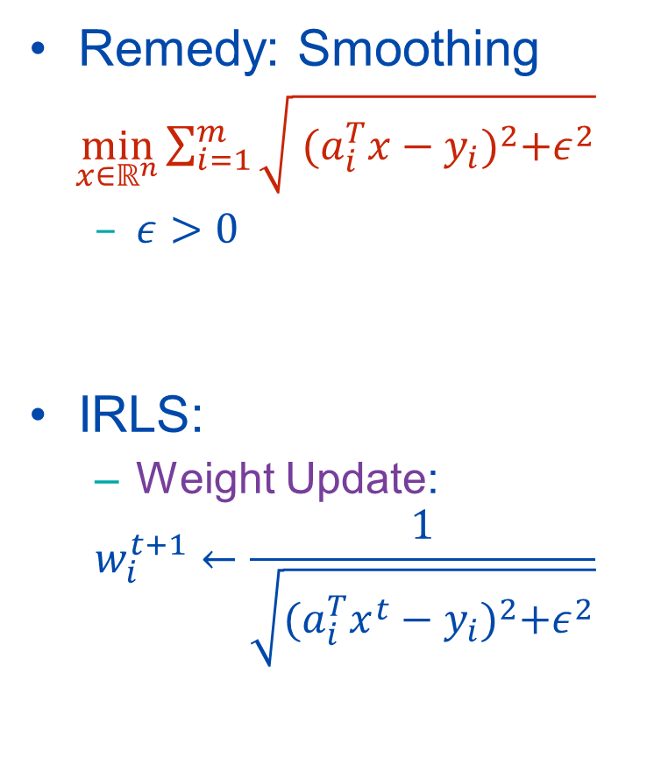


IRLS for Robust Linear Regression ($p=1$)
Remedy: Smoothing
$\min_{x∈ℝ^{n}}{\sum_{i=1}^{m}{\sqrt{{ (a_{i}^{T}x−y_{i})}^{2}+ε^{2}}}}$
$ε>0$
IRLS:
Weight Update:
$$w_{i}^{t+1}←\frac{1}{\sqrt{{(a_{i}^{T}x^{t}−y_{i})}^{2}+ε^{2}}}$$
Why IRLS works?
$\min_{x,w_{i}}{\sum_{i=1}^{m}{{w_{i}(a_{i}^{T}x−y_{i})}^{2}}}+\frac{2+w_{i}^{2}ε^{2}}{w_{i}}$
s.t. $w_{i}>0$
Equivalence:
RHS strictly convex in $w_{i}$
Fix $x$, optimal weight $w_{i}$ is
$w_{i}=\frac{1}{\sqrt{{(a_{i}^{T}x−y_{i})}^{2}+ε^{2}}}$ (OPT-w)
Substitute (OPT-w) into RHS yields LHS
$$\overset{⇔}{1}$$
Why IRLS works? Or why it doesn’t?

Slide 13


IRLS for Robust Linear Regression ($p=1$)
Remedy: Smoothing
$\min_{x∈ℝ^{n}}{\sum_{i=1}^{m}{\sqrt{{ (a_{i}^{T}x−y_{i})}^{2}+ε^{2}}}}$
$ε>0$
IRLS:
Weight Update:
$$w_{i}^{t+1}←\frac{1}{\sqrt{{(a_{i}^{T}x^{t}−y_{i})}^{2}+ε^{2}}}$$
Why IRLS works?
$\min_{x,w_{i}}{\sum_{i=1}^{m}{{w_{i}(a_{i}^{T}x−y_{i})}^{2}}}+\frac{2+w_{i}^{2}ε^{2}}{w_{i}}$
s.t. $w_{i}>0$
$w_{i}=\frac{1}{\sqrt{{(a_{i}^{T}x−y_{i})}^{2}+ε^{2}}}$ (OPT-w)
2. IRLS = Alt. Min. for RHS
Weight Update: Given $x^{t}$, minimizes RHS in $w_{i}$
Variable Update: Given $w_{i}^{t+1}$, minimizes RHS in $x$
3. Convergence ensues [1]
$$\overset{⇔}{1}$$
Why IRLS works? Or why it doesn’t?
[1] A. Beck. On the convergence of alternating minimization for convex programming with applications to iteratively reweighted least squares and decomposition schemes. SIAM Journal on Optimization, 2015.

Slide 14
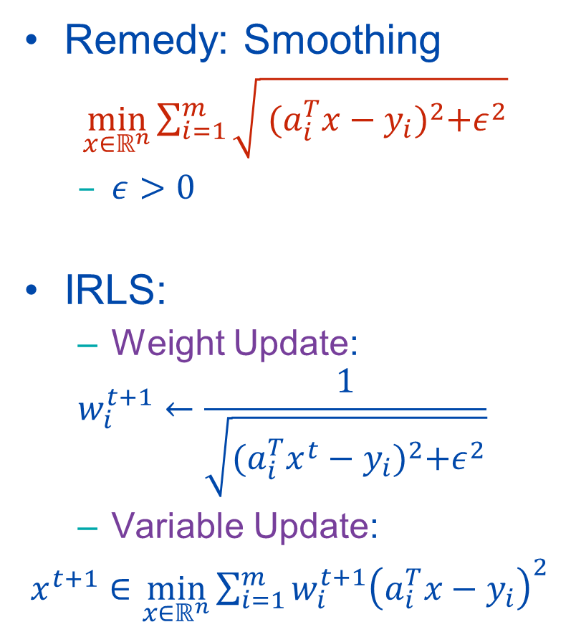

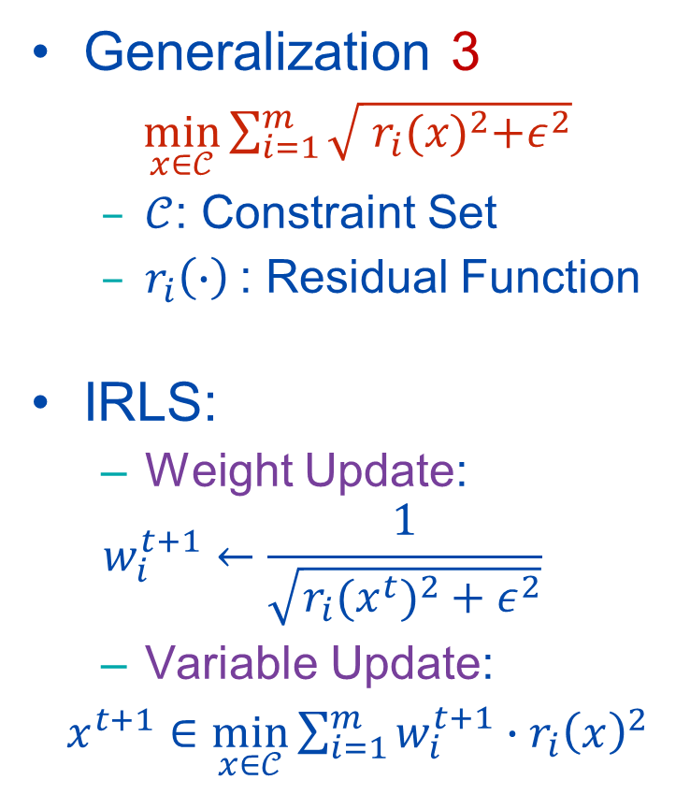
Smoothed $ℓ_{1}$ Minimization
Remedy: Smoothing
$\min_{x∈ℝ^{n}}{\sum_{i=1}^{m}{\sqrt{{ (a_{i}^{T}x−y_{i})}^{2}+ε^{2}}}}$
$ε>0$
IRLS:
Weight Update:
$$w_{i}^{t+1}←\frac{1}{\sqrt{{(a_{i}^{T}x^{t}−y_{i})}^{2}+ε^{2}}}$$
Variable Update:
$x^{t+1}∈\min_{x∈ℝ^{n}}{\sum_{i=1}^{m}{w_{i}^{t+1}{\left(a_{i}^{T}x−y_{i}\right)}^{2}}}$
Generalization 3
$\min_{x∈𝒞}{\sum_{i=1}^{m}{\sqrt{{ r_{i}(x)}^{2}+ε^{2}}}}$
$𝒞$: Constraint Set
$r_{i}\left(∙\right)$: Residual Function
IRLS:
Weight Update:
$$w_{i}^{t+1}←\frac{1}{\sqrt{{r_{i}(x^{t})}^{2}+ε^{2}}}$$
Variable Update:
$x^{t+1}∈\min_{x∈𝒞}{\sum_{i=1}^{m}{w_{i}^{t+1}∙{r_{i}\left(x\right)}^{2}}}$

Slide 15
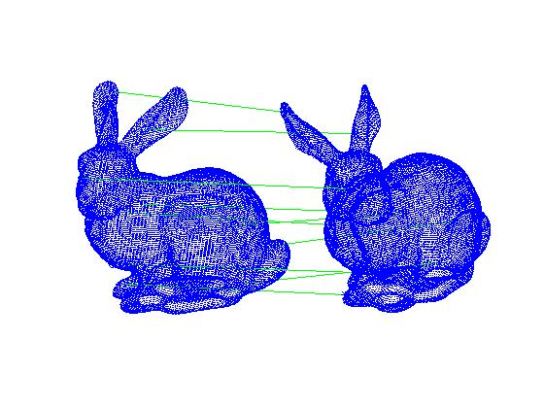
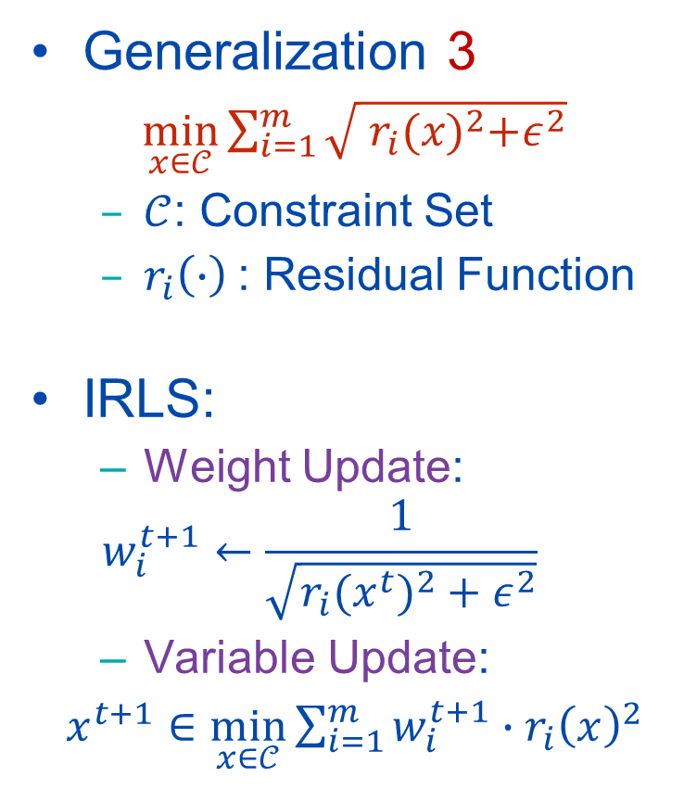
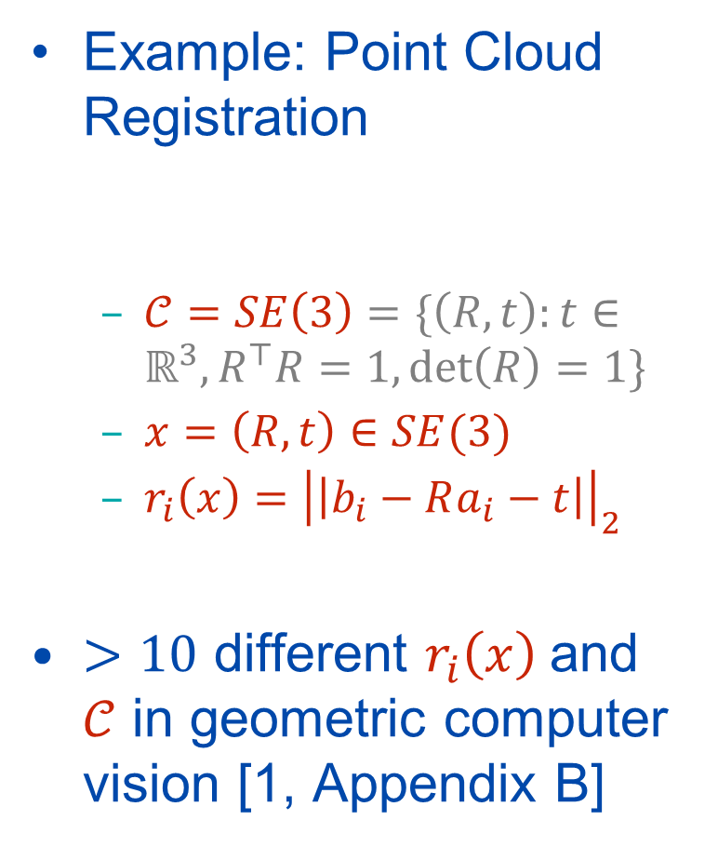
Smoothed $ℓ_{1}$ Minimization
Generalization 3
$\min_{x∈𝒞}{\sum_{i=1}^{m}{\sqrt{{ r_{i}(x)}^{2}+ε^{2}}}}$
$𝒞$: Constraint Set
$r_{i}\left(∙\right)$: Residual Function
IRLS:
Weight Update:
$$w_{i}^{t+1}←\frac{1}{\sqrt{{r_{i}(x^{t})}^{2}+ε^{2}}}$$
Variable Update:
$x^{t+1}∈\min_{x∈𝒞}{\sum_{i=1}^{m}{w_{i}^{t+1}∙{r_{i}\left(x\right)}^{2}}}$
Example: Point Cloud Registration
$𝒞=SE\left(3\right)=\{\left(R,t\right):t∈ℝ^{3},R^{⊤}R=1,\det\left(R\right)=1\}$
$x=\left(R,t\right)∈SE(3)$
$r_{i}\left(x\right)={\left|\left|b_{i}−Ra_{i}−t\right|\right|}_{2}$
$>10$ different $r_{i}\left(x\right)$and $𝒞$ in geometric computer vision [1, Appendix B]
[1] L. Peng , C. Kümmerle, and R. Vidal. On the Convergence of IRLS and Its Variants in Outlier-Robust Estimation. CVPR 2023.

Slide 16

Outlier-Robust Estimation
Generalization 3
$\min_{x∈𝒞}{\sum_{i=1}^{m}{\sqrt{{ r_{i}(x)}^{2}+ε^{2}}}}$
$𝒞$: Constraint Set
$r_{i}\left(∙\right)$: Residual Function
IRLS:
Weight Update:
$$w_{i}^{t+1}←\frac{1}{\sqrt{{r_{i}(x^{t})}^{2}+ε^{2}}}$$
Variable Update:
$x^{t+1}∈\min_{x∈𝒞}{\sum_{i=1}^{m}{w_{i}^{t+1}∙{r_{i}\left(x\right)}^{2}}}$
Generalization 4
$\min_{x∈𝒞}{\sum_{i=1}^{m}{ρ\left(r_{i}\left(x\right)\right)}}$
$ρ$: “Outlier-Robust Loss”

Slide 17
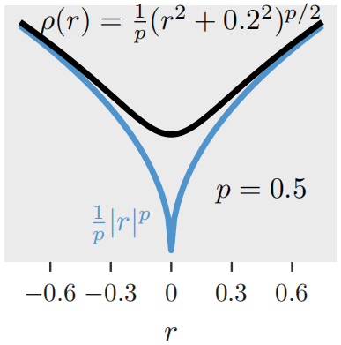

Outlier-Robust Estimation
Generalization 3
$\min_{x∈𝒞}{\sum_{i=1}^{m}{\sqrt{{ r_{i}(x)}^{2}+ε^{2}}}}$
$𝒞$: Constraint Set
$r_{i}\left(∙\right)$: Residual Function
IRLS:
Weight Update:
$$w_{i}^{t+1}←\frac{1}{\sqrt{{r_{i}(x^{t})}^{2}+ε^{2}}}$$
Variable Update:
$x^{t+1}∈\min_{x∈𝒞}{\sum_{i=1}^{m}{w_{i}^{t+1}∙{r_{i}\left(x\right)}^{2}}}$
Generalization 4
$\min_{x∈𝒞}{\sum_{i=1}^{m}{ρ\left(r_{i}\left(x\right)\right)}}$
$ρ$: “Outlier-Robust Loss”
smoothed $ℓ_{p}$-loss

Slide 18
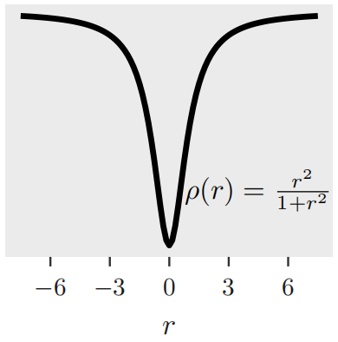
Outlier-Robust Estimation
Generalization 3
$\min_{x∈𝒞}{\sum_{i=1}^{m}{\sqrt{{ r_{i}(x)}^{2}+ε^{2}}}}$
$𝒞$: Constraint Set
$r_{i}\left(∙\right)$: Residual Function
IRLS:
Weight Update:
$$w_{i}^{t+1}←\frac{1}{\sqrt{{r_{i}(x^{t})}^{2}+ε^{2}}}$$
Variable Update:
$x^{t+1}∈\min_{x∈𝒞}{\sum_{i=1}^{m}{w_{i}^{t+1}∙{r_{i}\left(x\right)}^{2}}}$
Generalization 4
$\min_{x∈𝒞}{\sum_{i=1}^{m}{ρ\left(r_{i}\left(x\right)\right)}}$
$ρ$: “Outlier-Robust Loss”
Geman-McClure Loss [1]
[1] S. Geman and D.E. McClure. Bayesian image analysis: An application to single photon emission tomography. Proceedings of the American Statistical Association,1985.

Slide 19
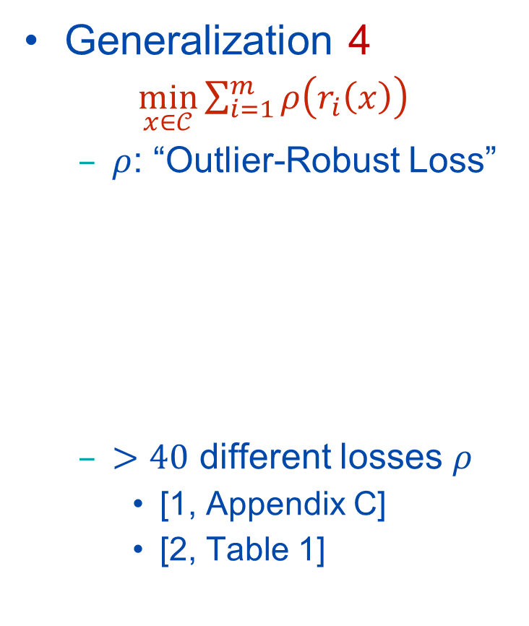
Outlier-Robust Estimation
Generalization 3
$\min_{x∈𝒞}{\sum_{i=1}^{m}{\sqrt{{ r_{i}(x)}^{2}+ε^{2}}}}$
$𝒞$: Constraint Set
$r_{i}\left(∙\right)$: Residual Function
IRLS:
Weight Update:
$$w_{i}^{t+1}←\frac{1}{\sqrt{{r_{i}(x^{t})}^{2}+ε^{2}}}$$
Variable Update:
$x^{t+1}∈\min_{x∈𝒞}{\sum_{i=1}^{m}{w_{i}^{t+1}∙{r_{i}\left(x\right)}^{2}}}$
Generalization 4
$\min_{x∈𝒞}{\sum_{i=1}^{m}{ρ\left(r_{i}\left(x\right)\right)}}$
$ρ$: “Outlier-Robust Loss”
$>40$ different losses $ρ$
[1, Appendix C]
[2, Table 1]
[1] D.Q.F. de Menezes, D.M. Prata, A.R. Secchi, and J.C. Pinto. A review on robust M-estimators for regression analysis. Computers & Chemical Engineering, 2021.
[2] A. Chatterjee and Venu Madhav Govindu. Robust relative rotation averaging. T-PAMI 2017.

Slide 20
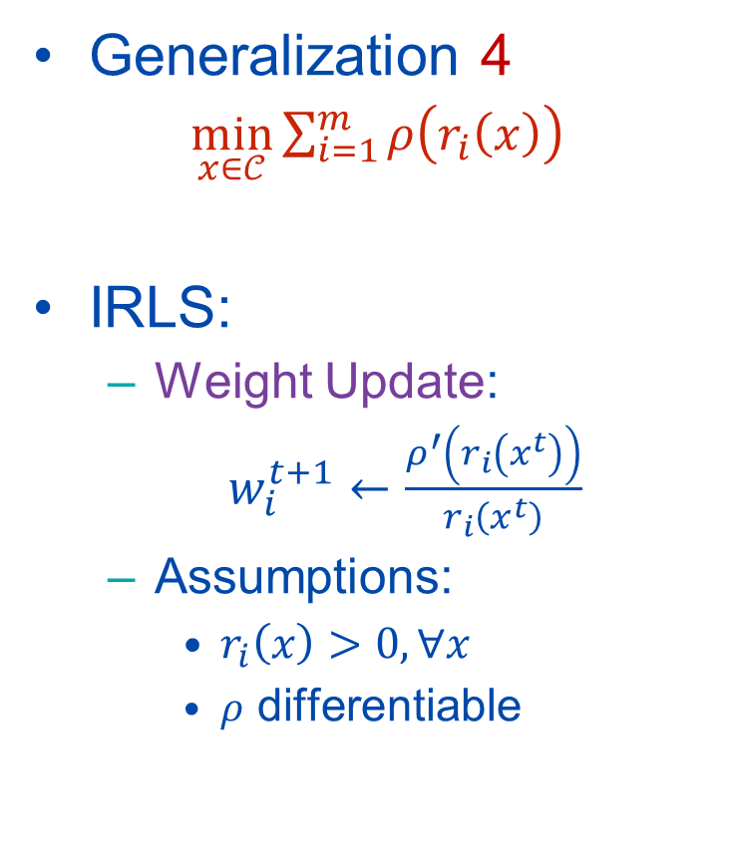
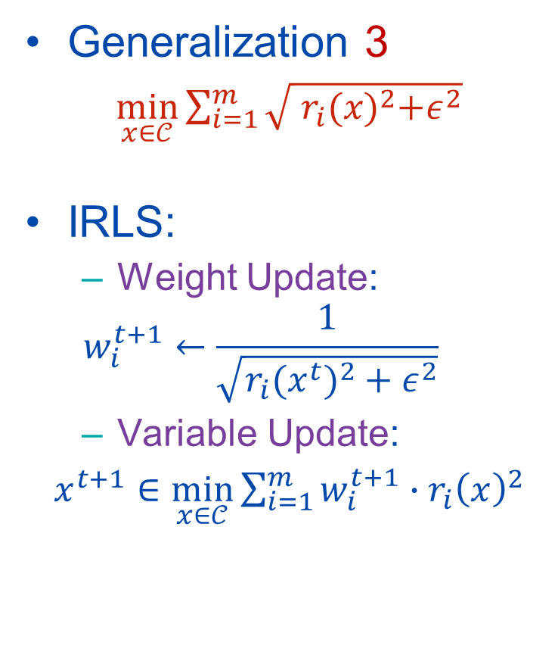
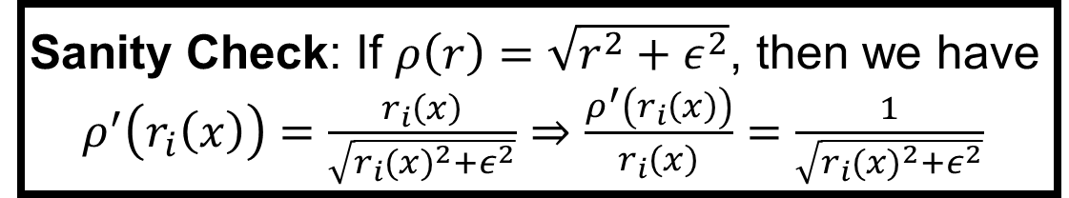
IRLS for Outlier-Robust Estimation
Generalization 3
$\min_{x∈𝒞}{\sum_{i=1}^{m}{\sqrt{{ r_{i}(x)}^{2}+ε^{2}}}}$
IRLS:
Weight Update:
$$w_{i}^{t+1}←\frac{1}{\sqrt{{r_{i}(x^{t})}^{2}+ε^{2}}}$$
Variable Update:
$x^{t+1}∈\min_{x∈𝒞}{\sum_{i=1}^{m}{w_{i}^{t+1}∙{r_{i}\left(x\right)}^{2}}}$
Generalization 4
$\min_{x∈𝒞}{\sum_{i=1}^{m}{ρ\left(r_{i}\left(x\right)\right)}}$
IRLS:
Weight Update:
$w_{i}^{t+1}←\frac{ρ^{′}\left(r_{i}\left(x^{t}\right)\right)}{r_{i}\left(x^{t}\right)}$
Assumptions:
$r_{i}\left(x\right)>0,∀x$
$ρ$ differentiable
Sanity Check: If $ρ\left(r\right)=\sqrt{r^{2}+ε^{2}}$, then we have
$ρ^{′}\left(r_{i}\left(x\right)\right)=\frac{r_{i}\left(x\right)}{\sqrt{{r_{i}(x)}^{2}+ε^{2}}}⇒\frac{ρ^{′}\left(r_{i}\left(x\right)\right)}{r_{i}\left(x\right)}=\frac{1}{\sqrt{{r_{i}(x)}^{2}+ε^{2}}}$

Slide 21
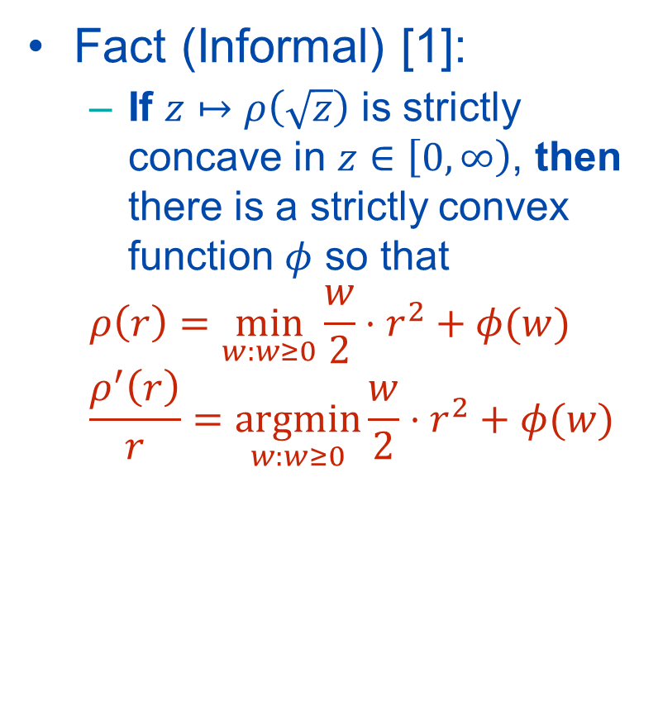
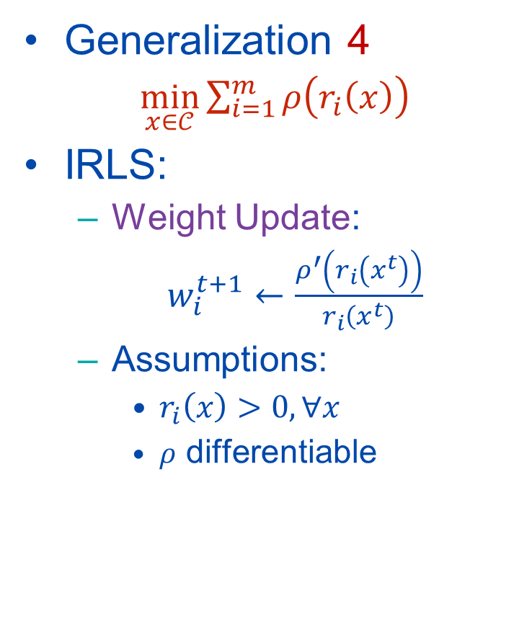
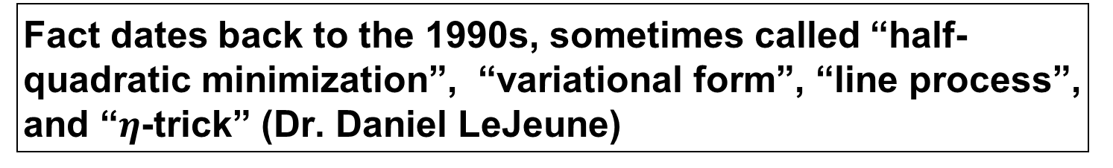
IRLS for Outlier-Robust Estimation
Generalization 4
$\min_{x∈𝒞}{\sum_{i=1}^{m}{ρ\left(r_{i}\left(x\right)\right)}}$
IRLS:
Weight Update:
$w_{i}^{t+1}←\frac{ρ^{′}\left(r_{i}\left(x^{t}\right)\right)}{r_{i}\left(x^{t}\right)}$
Assumptions:
$r_{i}\left(x\right)>0,∀x$
$ρ$ differentiable
Fact (Informal) [1]:
If $z↦ρ\left(\sqrt{z}\right)$ is strictly concave in $z∈\left[0,∞\right)$, then there is a strictly convex function $φ$ so that
$$ρ\left(r\right)=\min_{w:w≥0}{\frac{w}{2}⋅r^{2}+φ(w)}$$
$$\frac{ρ^{′}\left(r\right)}{r}=\underset{w:w≥0}{argmin}{\frac{w}{2}⋅r^{2}+φ(w)}$$
(OPT-w)
Fact dates back to the 1990s, sometimes called “half-quadratic minimization”, “variational form”, “line process”, and “$η$-trick” (Dr. Daniel LeJeune)
[1] C. Poon and G. Peyré, Smooth Bilevel Programming for Sparse Regularization, NeurIPS 2021.

Slide 22
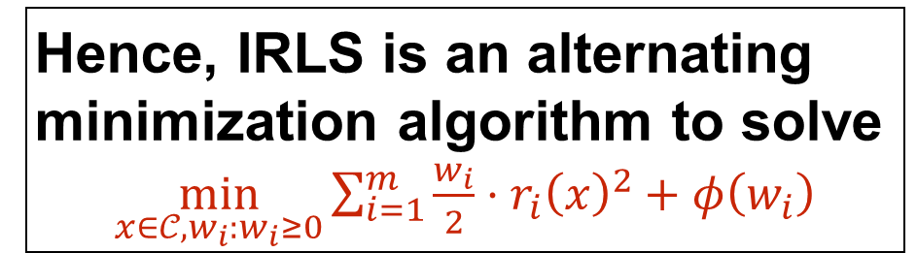
IRLS for Outlier-Robust Estimation
Generalization 4
$\min_{x∈𝒞}{\sum_{i=1}^{m}{ρ\left(r_{i}\left(x\right)\right)}}$
IRLS:
Weight Update:
$w_{i}^{t+1}←\frac{ρ^{′}\left(r_{i}\left(x^{t}\right)\right)}{r_{i}\left(x^{t}\right)}$
Assumptions:
$r_{i}\left(x\right)>0,∀x$
$ρ$ differentiable
Fact (Informal) [1]:
If $z↦ρ\left(\sqrt{z}\right)$ is strictly concave in $z∈\left[0,∞\right)$, then there is a strictly convex function $φ$ so that
$$ρ\left(r\right)=\min_{w:w≥0}{\frac{w}{2}⋅r^{2}+φ(w)}$$
$$\frac{ρ^{′}\left(r\right)}{r}=\underset{w:w≥0}{argmin}{\frac{w}{2}⋅r^{2}+φ(w)}$$
(OPT-w)
Hence, IRLS is an alternating minimization algorithm to solve
$\min_{x∈𝒞,w_{i}:w_{i}≥0}{\sum_{i=1}^{m}{\frac{w_{i}}{2}⋅r_{i}{\left(x\right)}^{2}+φ\left(w_{i}\right)}}$
[1] C. Poon and G. Peyré, Smooth Bilevel Programming for Sparse Regularization, NeurIPS 2021.

Slide 23
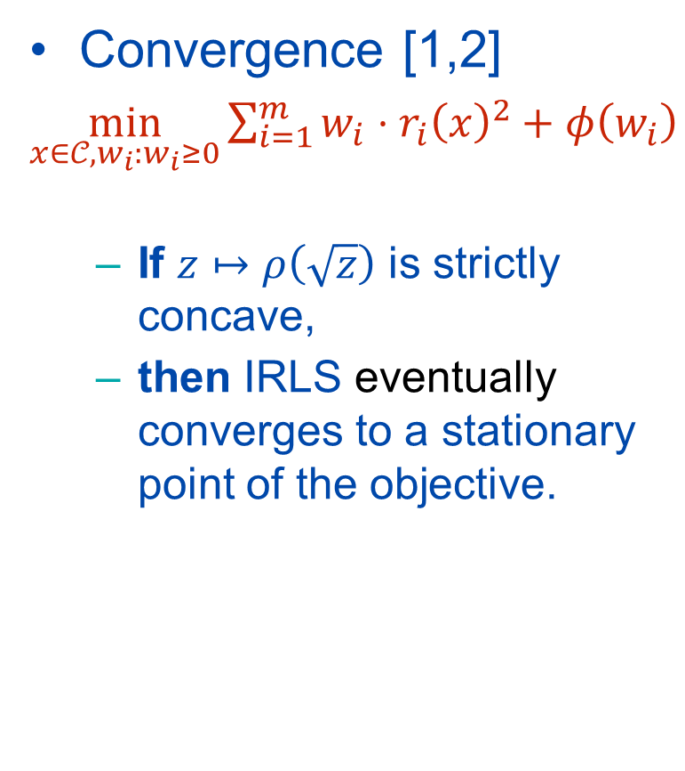
IRLS for Outlier-Robust Estimation
Generalization 4
$\min_{x∈𝒞}{\sum_{i=1}^{m}{ρ\left(r_{i}\left(x\right)\right)}}$
IRLS:
Weight Update:
$w_{i}^{t+1}←\frac{ρ^{′}\left(r_{i}\left(x^{t}\right)\right)}{r_{i}\left(x^{t}\right)}$
Assumptions:
$r_{i}\left(x\right)>0,∀x$
$ρ$ differentiable
Convergence [1,2]
$\min_{x∈𝒞,w_{i}:w_{i}≥0}{\sum_{i=1}^{m}{w_{i}⋅r_{i}{\left(x\right)}^{2}+φ\left(w_{i}\right)}}$
If $z↦ρ\left(\sqrt{z}\right)$ is strictly concave,
then IRLS eventually converges to a stationary point of the objective.
[1] K. Aftab and R. Hartley. Convergence of Iteratively Re-Weighted Least Squares to Robust M-Estimators. WACV 2015.
[2] L. Peng , C. Kümmerle, and R. Vidal. On the Convergence of IRLS and Its Variants in Outlier-Robust Estimation. CVPR 2023.

Slide 24
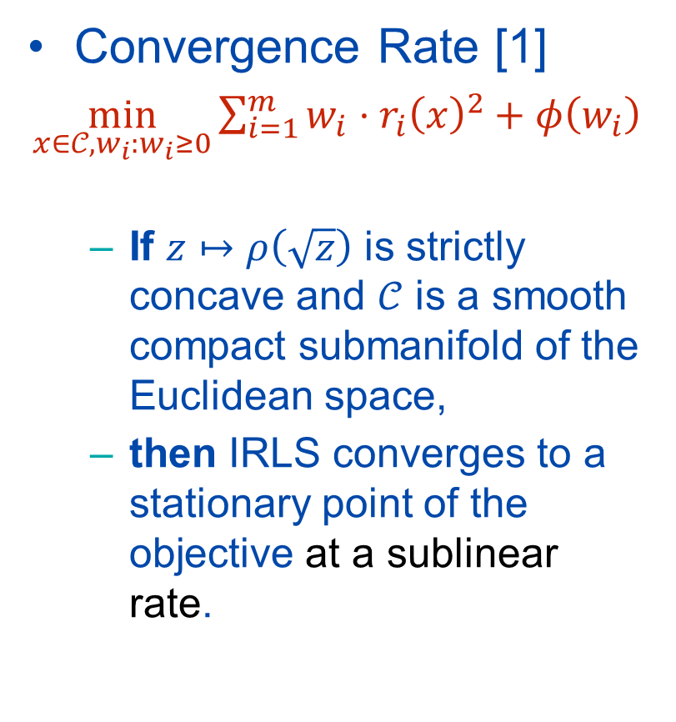
IRLS for Outlier-Robust Estimation
Generalization 4
$\min_{x∈𝒞}{\sum_{i=1}^{m}{ρ\left(r_{i}\left(x\right)\right)}}$
IRLS:
Weight Update:
$w_{i}^{t+1}←\frac{ρ^{′}\left(r_{i}\left(x^{t}\right)\right)}{r_{i}\left(x^{t}\right)}$
Assumptions:
$r_{i}\left(x\right)>0,∀x$
$ρ$ differentiable
Convergence Rate [1]
$\min_{x∈𝒞,w_{i}:w_{i}≥0}{\sum_{i=1}^{m}{w_{i}⋅r_{i}{\left(x\right)}^{2}+φ\left(w_{i}\right)}}$
If $z↦ρ\left(\sqrt{z}\right)$ is strictly concave and $𝒞$ is a smooth compact submanifold of the Euclidean space,
then IRLS converges to a stationary point of the objective at a sublinear rate.
[1] L. Peng and R. Vidal. Block Coordinate Descent on Smooth Manifolds. arXiv:2305.14744 [math.OC] 2023.

Slide 25
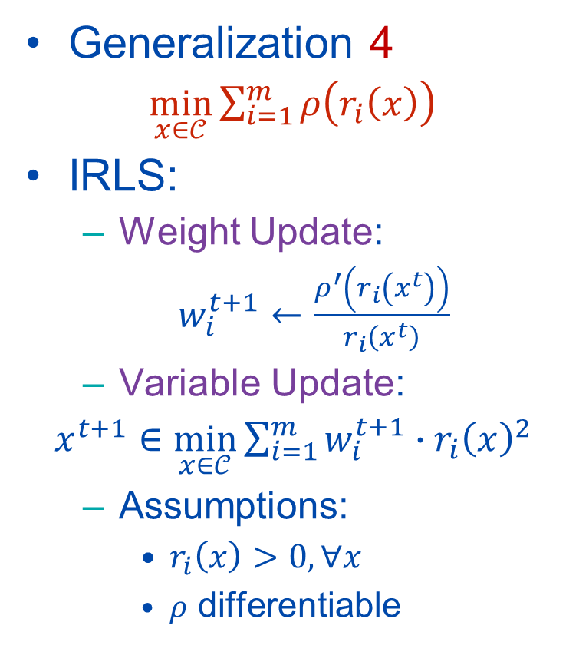
What Else?
Generalization 4
$\min_{x∈𝒞}{\sum_{i=1}^{m}{ρ\left(r_{i}\left(x\right)\right)}}$
IRLS:
Weight Update:
$w_{i}^{t+1}←\frac{ρ^{′}\left(r_{i}\left(x^{t}\right)\right)}{r_{i}\left(x^{t}\right)}$
Variable Update:
$x^{t+1}∈\min_{x∈𝒞}{\sum_{i=1}^{m}{w_{i}^{t+1}∙{r_{i}\left(x\right)}^{2}}}$
Assumptions:
$r_{i}\left(x\right)>0,∀x$
$ρ$ differentiable
Implementation?
If Variable Update has closed-form solution (e.g., least-squares or SVD)
Accelerated or inexact solvers (Dr. Silvia Gazzola)
If Variable Update does not have closed-form solution:
Riemannian optimization
SDP relaxations [1]
[1] H. Yang, P. Antonante, V. Tzoumas, L. Carlone. Graduated non-convexity for robust spatial perception: From non-minimal solvers to global outlier rejection. RA-L 2020.

Slide 26
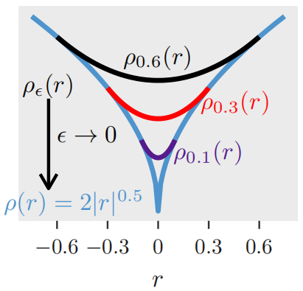
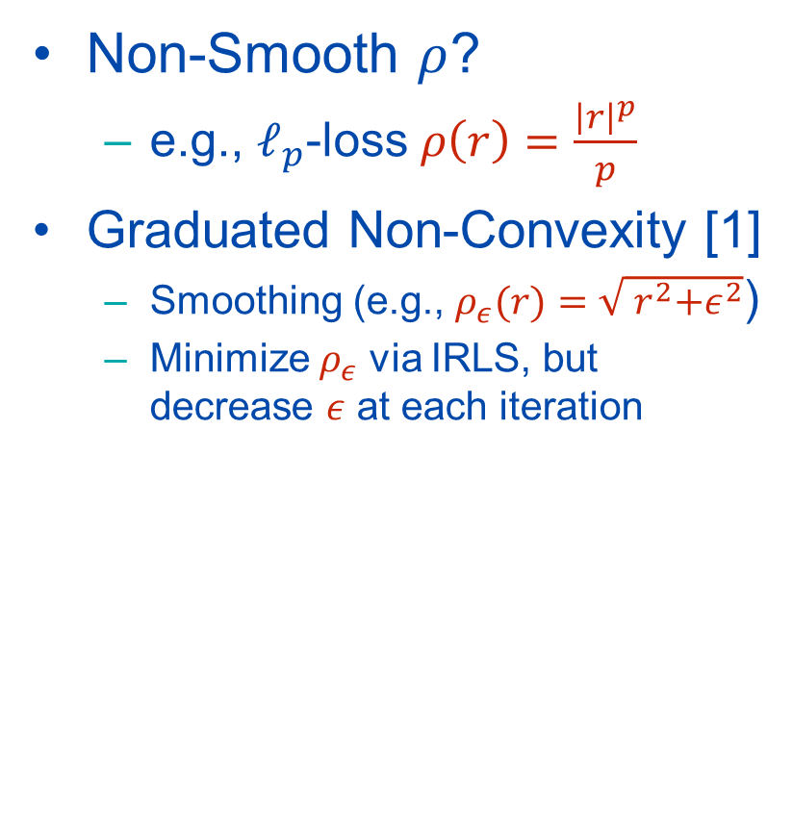
What Else?
Generalization 4
$\min_{x∈𝒞}{\sum_{i=1}^{m}{ρ\left(r_{i}\left(x\right)\right)}}$
IRLS:
Weight Update:
$w_{i}^{t+1}←\frac{ρ^{′}\left(r_{i}\left(x^{t}\right)\right)}{r_{i}\left(x^{t}\right)}$
Variable Update:
$x^{t+1}∈\min_{x∈𝒞}{\sum_{i=1}^{m}{w_{i}^{t+1}∙{r_{i}\left(x\right)}^{2}}}$
Assumptions:
$r_{i}\left(x\right)>0,∀x$
$ρ$ differentiable
Non-Smooth $ρ$?
e.g., $ℓ_{p}$-loss $ρ\left(r\right)=\frac{{\left|r\right|}^{p}}{p}$
Graduated Non-Convexity [1]
Smoothing (e.g., $ρ_{ε}(r)=\sqrt{{ r}^{2}+ε^{2}}$)
Minimize $ρ_{ε}$ via IRLS, but decrease $ε$ at each iteration
[1] A. Blake and A. Zisserman. Visual Reconstruction. MIT Press, 1987.

Slide 27
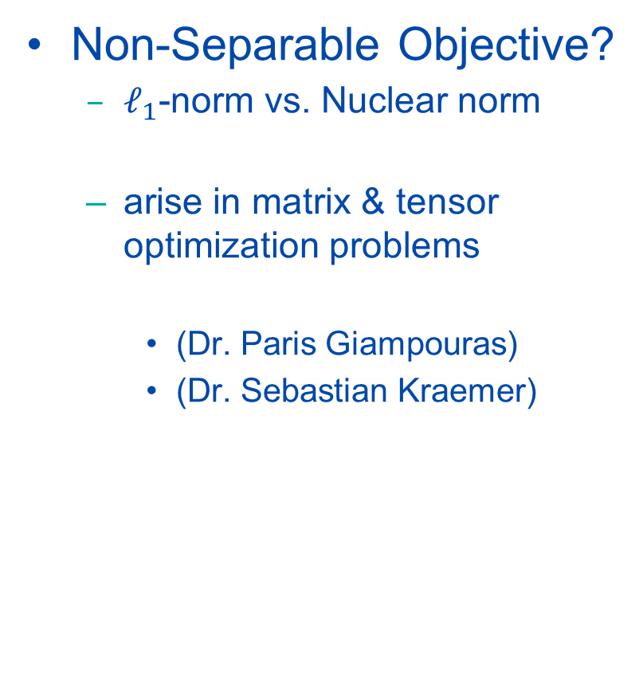
What Else?
Generalization 4
$\min_{x∈𝒞}{\sum_{i=1}^{m}{ρ\left(r_{i}\left(x\right)\right)}}$
IRLS:
Weight Update:
$w_{i}^{t+1}←\frac{ρ^{′}\left(r_{i}\left(x^{t}\right)\right)}{r_{i}\left(x^{t}\right)}$
Variable Update:
$x^{t+1}∈\min_{x∈𝒞}{\sum_{i=1}^{m}{w_{i}^{t+1}∙{r_{i}\left(x\right)}^{2}}}$
Assumptions:
$r_{i}\left(x\right)>0,∀x$
$ρ$ differentiable
Non-Separable Objective?
$ℓ_{1}$-norm vs. Nuclear norm
arise in matrix & tensor optimization problems
(Dr. Paris Giampouras)
(Dr. Sebastian Kraemer)

Slide 28
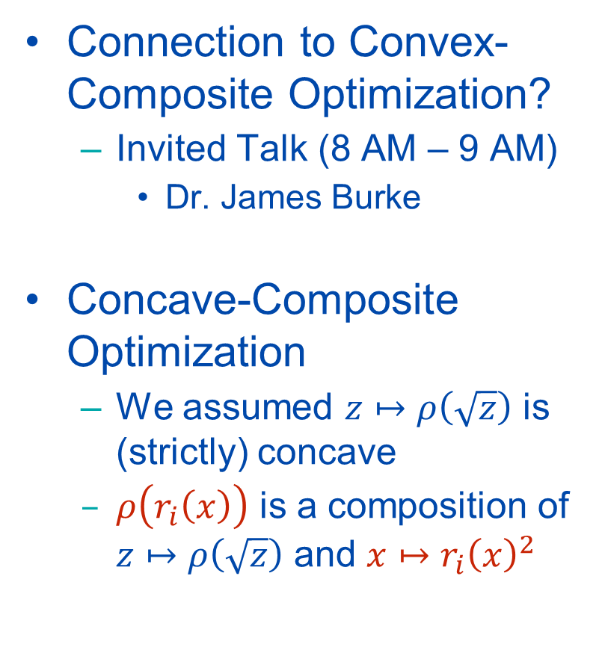
What Else?
Generalization 4
$\min_{x∈𝒞}{\sum_{i=1}^{m}{ρ\left(r_{i}\left(x\right)\right)}}$
IRLS:
Weight Update:
$w_{i}^{t+1}←\frac{ρ^{′}\left(r_{i}\left(x^{t}\right)\right)}{r_{i}\left(x^{t}\right)}$
Variable Update:
$x^{t+1}∈\min_{x∈𝒞}{\sum_{i=1}^{m}{w_{i}^{t+1}∙{r_{i}\left(x\right)}^{2}}}$
Assumptions:
$r_{i}\left(x\right)>0,∀x$
$ρ$ differentiable
Connection to Convex-Composite Optimization?
Invited Talk (8 AM – 9 AM)
Dr. James Burke
Concave-Composite Optimization
We assumed $z↦ρ\left(\sqrt{z}\right)$ is (strictly) concave
$ρ\left(r_{i}\left(x\right)\right)$ is a composition of $z↦ρ\left(\sqrt{z}\right)$ and ${x↦r}_{i}{\left(x\right)}^{2}$

Slide 29
More Information
This work was supported by grants NSF 1704458, NSF 1934979, ONR MURI 503405-78051, and the Northrop Grumman Mission Systems Research in Applications for Learning Machines (REALM) initiative.
Vision Lab @ JHU http://www.vision.jhu.edu
Innovation in Data Engineering and Science (IDEAS) @ UPenn https://research.seas.upenn.edu/initiatives/data-science/
Thank You!

